Slide 1
NLP for Television Series and their Episodes
ECE 4990 – AI Security and Privacy
Project Proposal
Rajat Sethi

Slide 2
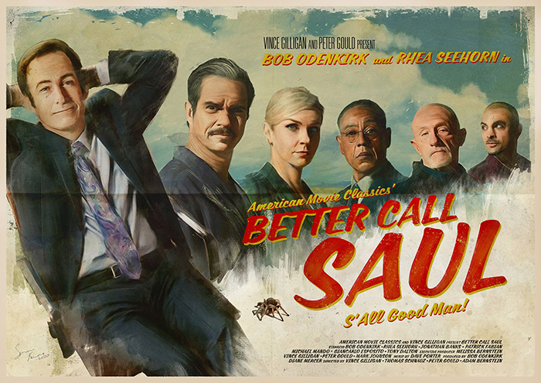
Jolly Good Show
TV Series are a great leisure.
Like Novels/Plays, but better.
Thoughtful scriptwriting and camerawork.

Slide 3
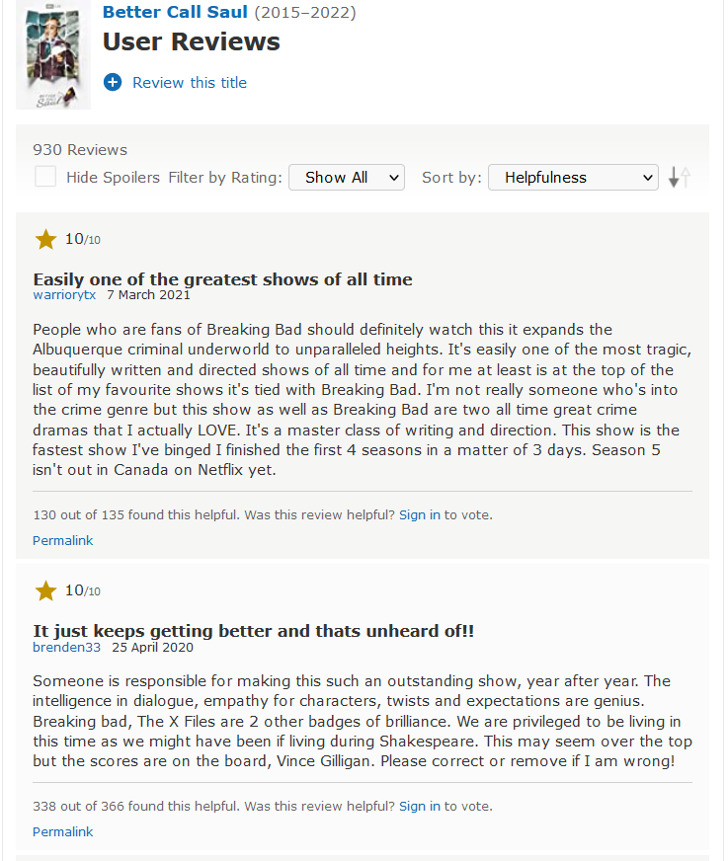
What makes a good show?
Literary analysis can help, but too “subjective” by itself.
IMDb Reviews have a great sample size.

Slide 4
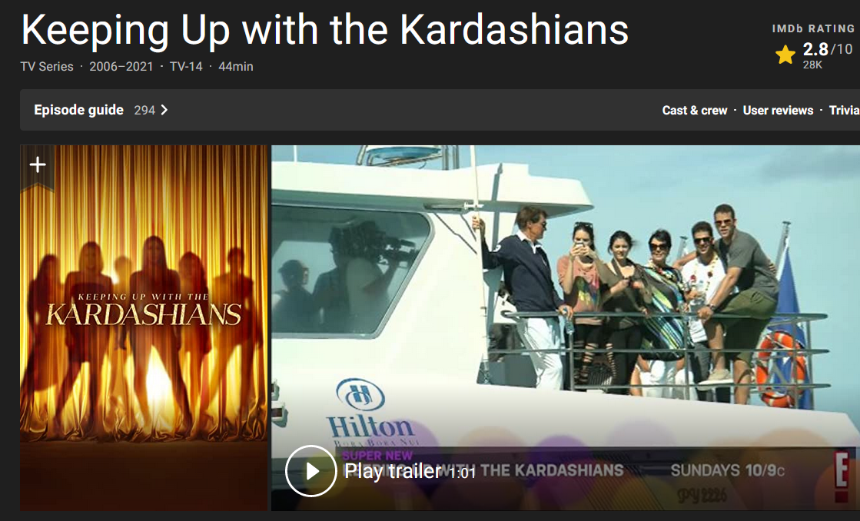
What makes a bad show?
Not all shows are masterpieces.
Associate bad shows with negative reviews.

Slide 5
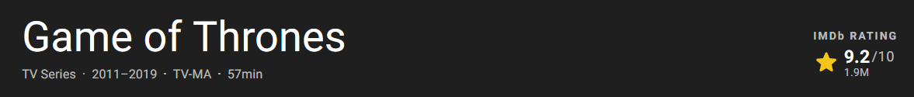
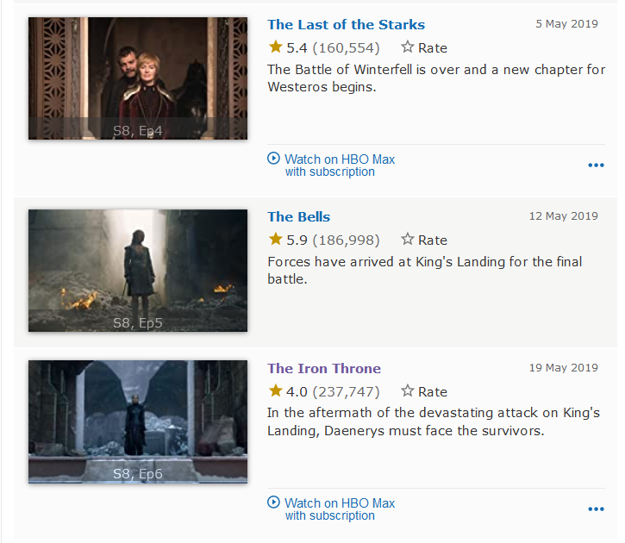
Episode Granularity
Great Show with Bad Episodes
OR
Bad Show with Great Episodes

Slide 6
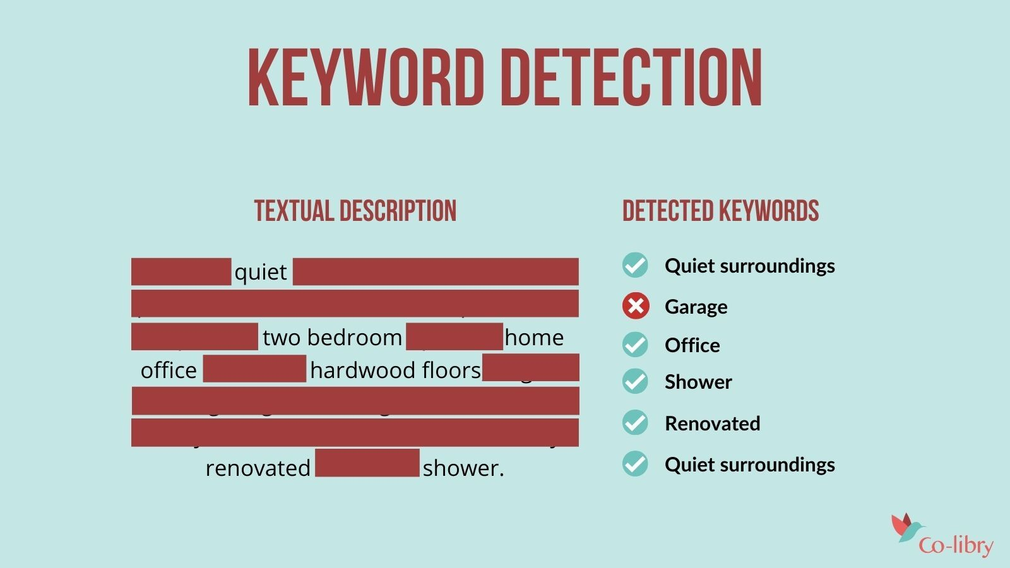
Natural Language Processing
Associate review keywords with scores.
Determine what aspects make a good (or bad) show.

Slide 7
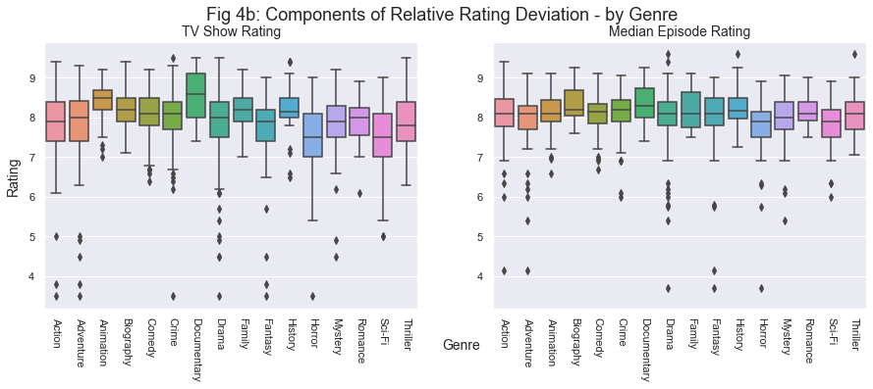
Overall Goals
Comprehensive understanding of great shows/episodes.
Awareness of terrible shows/episodes.
Statistical analysis linking phrases to scores.

